Slide 1

Capstone Project
The Battle of The Neighborhoods
(Week 1 + 2)
November 2, 2020

Slide 2
Background
In this project, we are to define a problem or an idea of our choice, where we would need to leverage location data to solve or execute. This submission will eventually be part of a Introduction/Business Problem section in a final report.

Slide 3
Introduction
The Covid-19 virus pandemic has completely changed the landscape for New York City, perhaps forever. The borders were shut down for travelers. Tourism vanished overnight, something that New York City feeds on. While the pandemic situation is catastrophic for many (hospitals, existing business owners, the municipality, etc to name a few), it may present an interesting opportunity for future business investment. Specifically, whether or not it would be wise to open up a Ramen shop in New York City. The massive closures happening in New York City, paired with the ballooning city budget deficits, is providing cheaper rents and more favorable new lease terms.

Slide 4
Data Used
For this project, we will leverage Foursquare location data to solve and execute. This data should include New York City longitude and latitude data, specifying neighborhoods, and data for different types of restaurants.
This project will require using many data science skills, from web scrapping (open source dataset), working with API (Foursquare), data cleaning, data wrangling, to map visualization (Folium).

Slide 5
Methodology
Item 1
Item 2
Item 3
Data will be collected from:
https://cocl.us/new_york_dataset
and cleaned and processed into a dataframe.
FourSquare be used to locate all venues and then filtered by Japanese restaurants. Ratings, tips, and likes by users will be counted and added to the dataframe.
• Data will be sorted based on rankings.

Slide 6
Problem Statement:
Where should one open a Ramen Shop/Japanese restaurant in New York City?

Slide 7
Target Audience
This study and recommendation will be beneficial for business investors and future entrepreneurs, in Japanese restaurants, looking to start or expand a business into the New York City Metropolitan area.

Slide 8
Let’s Dig Into the Data!
Results Section →

Slide 9
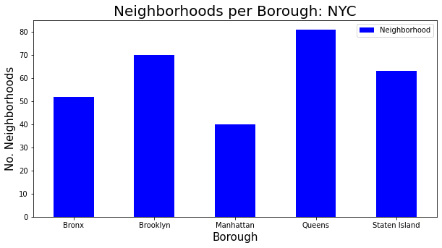
Look at the Neighborhoods First
We can see that Queens has the most neighborhoods, and Manhattan has the least

Slide 10
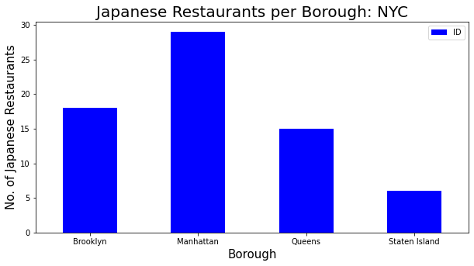
Refine down to Japanese Restaurants per Borough
We can see that Manhattan, while it has the least number of neighborhoods, it has the greatest number of Japanese restaurants

Slide 11
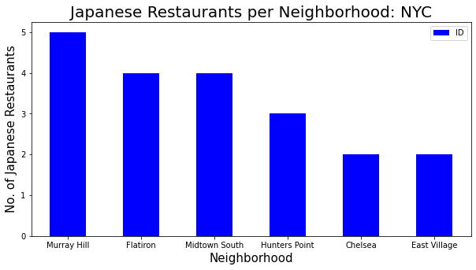
Refine down to Japanese Restaurants per Neighborhood
Within Manhattan, we can see that Murray Hill has the highest number of Japanese restaurants. The East Village and Chelsea have the least.

Slide 12
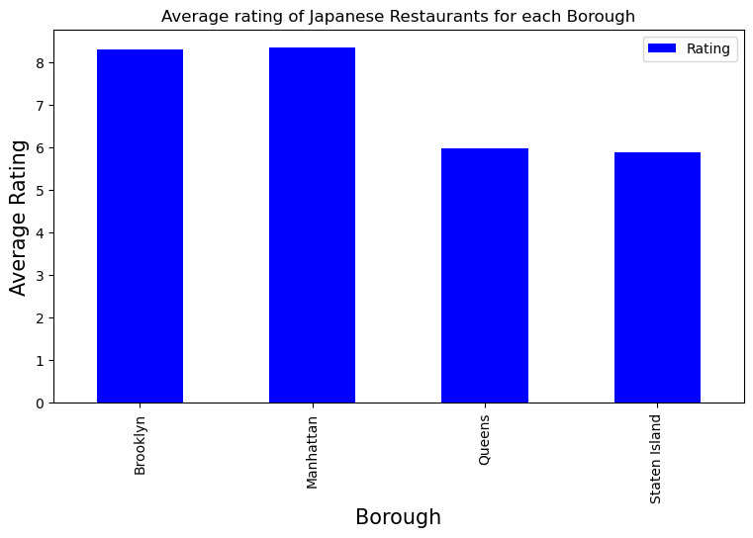
Refine down to Average Ratings of Japanese Restaurants in each Borough
Manhattan and Brooklyn have the highest average rating. The two highest average ratings, however, are both in Brooklyn

Slide 13
Discussion Section
Based on the data analysis above, we can see that Brooklyn and Manhattan offer the best rated Japanese restaurants average rating. Conversely, Staten Island, Queens, and The Bronx offer the least amount of Japanese restaurants. Manhattan and Brooklyn appear to have accepted Japanese restaurants, suggesting that the profile of taste buds are friendly to open up these type of restaurants. Given that Manhattan rental prices exceed those of Brooklyn on average, I would recommend targeting Brooklyn as the place of choice to open up a Japanese ramen shop. Brooklyn has average ratings over 8.0/10.0 and is much less dense.

Slide 14
Conclusion
It is important to highlight that this data analysis project is predicated on the Foursquare data accuracy. This project required us to use many data analysis skills of data extraction, data cleaning, data visualization, and analyzing the data thereafter for meaningful and actionable insight for relevant stakeholders. After our analysis, we were able to answer our question: “Is it a good time to open a Ramen Shop/Asian restaurant in New York City?” and conclude that it is a good time to open up a shop in Brooklyn or Manhattan.

